Slide 1
Bringing a buzz to NECTAR: Encouraging take up and embedding through new repository services
Miggie Pickton
UKCoRR Meeting, University of Salford
25th February 2011

Slide 2
Context for the project
Well established (since 2007/8) repository at a ‘new’ university
Currently successful in research reporting but less so in providing open access to full text
Highly mediated service is proving difficult to sustain
Mandate for electronic submission of theses is about to take effect
Like everyone else, we’re wondering how we can best support the REF

Slide 3
Project objectives
To modify university procedures for submission to NECTAR increase researcher involvement, encourage the deposit of full content and further embed NECTAR in researcher workflows.
To implement technical and procedural changes as necessary to ensure NECTAR is compatible with the requirements of the British Library’s EThOS service.
To implement technical and procedural solutions (when available) to ensure NECTAR is ready to support the Research Excellence Framework (REF).
Through implementation of the Eprints Kultur plugin and rebranding of the repository interface, to better display the creative research outputs of the institution and to visually embed NECTAR within The University of Northampton’s new university website.

Slide 4
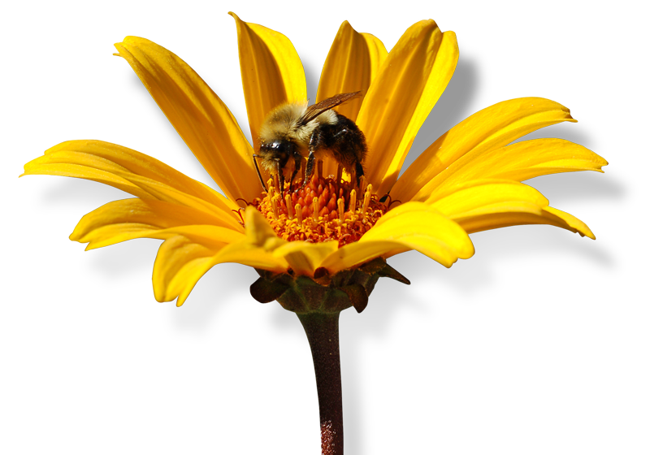
Project objectives
To implement the sector’s best ideas for new ‘added value’ services from NECTAR (e.g. personal bibliographies on staff profile pages) to increased the perceived benefit of NECTAR.
To provide a programme of appropriate training, advocacy and promotional activity to support the changes described above.
To collaborate with colleagues in the Repositories Support Project (RSP) and UKCoRR to ensure that best practice is followed.

Slide 5
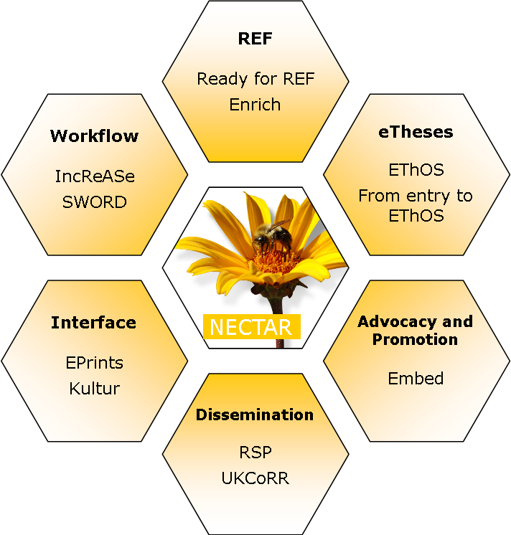
Learning from others

Slide 6
Progress so far
NECTAR has been rebranded to match the university website
Changes to workflow have been implemented and promoted
Ongoing advocacy activity includes presentations to research groups and School Research Forums
Eprints Services will shortly start work on Kultur and EThOS extensions (they are currently working on a RefWorks import for us – this will be made available to the Eprints community soon)
Lots still to do!

Slide 7
If you want to know more about any part of the project
then please contact
Miggie Pickton
NECTAR Queen Bee
miggie.pickton@northampton.ac.uk
We are grateful to the JISC for their support.

